Slide 1
Chapter 4
The Solar Resource

Slide 2
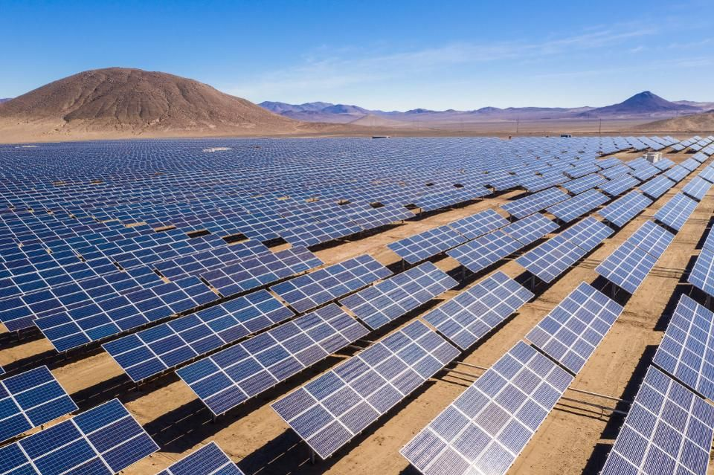
The solar resource
Solar energy is radiant light and heat from the Sun that is harnessed using a range of ever-evolving technologies such as solar heating, photovoltaics, solar thermal energy, solar architecture, molten salt power plants and artificial photosynthesis.

Slide 3
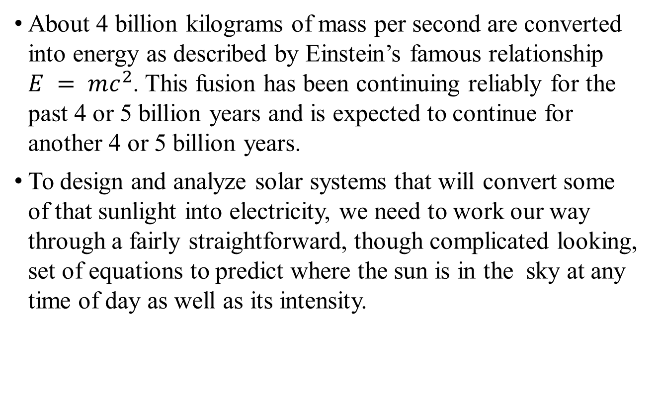
The solar resource
About 4 billion kilograms of mass per second are converted into energy as described by Einstein’s famous relationship $E = mc^{2}$. This fusion has been continuing reliably for the past 4 or 5 billion years and is expected to continue for another 4 or 5 billion years.
To design and analyze solar systems that will convert some of that sunlight into electricity, we need to work our way through a fairly straightforward, though complicated looking, set of equations to predict where the sun is in the sky at any time of day as well as its intensity.

Slide 4
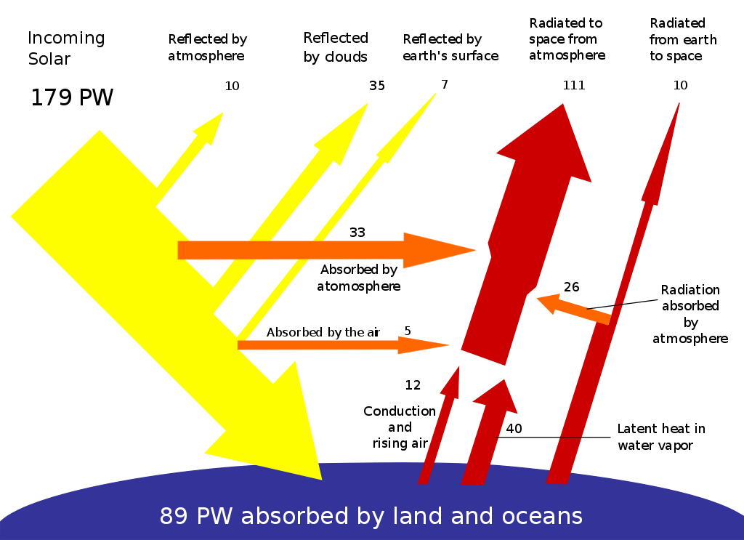
The solar resource
The Earth receives 174 petawatts (PW) of incoming solar radiation (insolation) at the upper atmosphere. Approximately 30% is reflected back to space while the rest is absorbed by clouds, oceans and land masses

Slide 5
The solar resource
Solar power is the conversion of sunlight into electricity, either directly using photovoltaics (PV), or indirectly using concentrated solar power (CSP).
In the last two decades, photovoltaics (PV), also known as solar PV, has evolved from a pure niche market of small scale applications towards becoming a mainstream electricity source.
A solar cell is a device that converts light directly into electricity using the photoelectric effect.

Slide 6
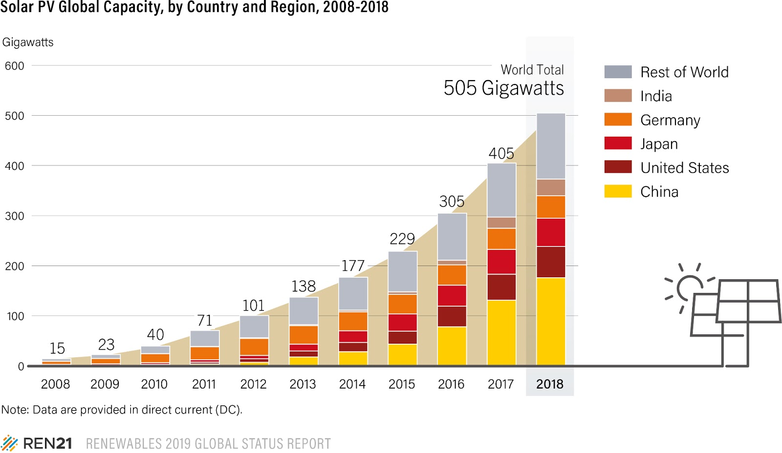
Worldwide PV Installation

Slide 7
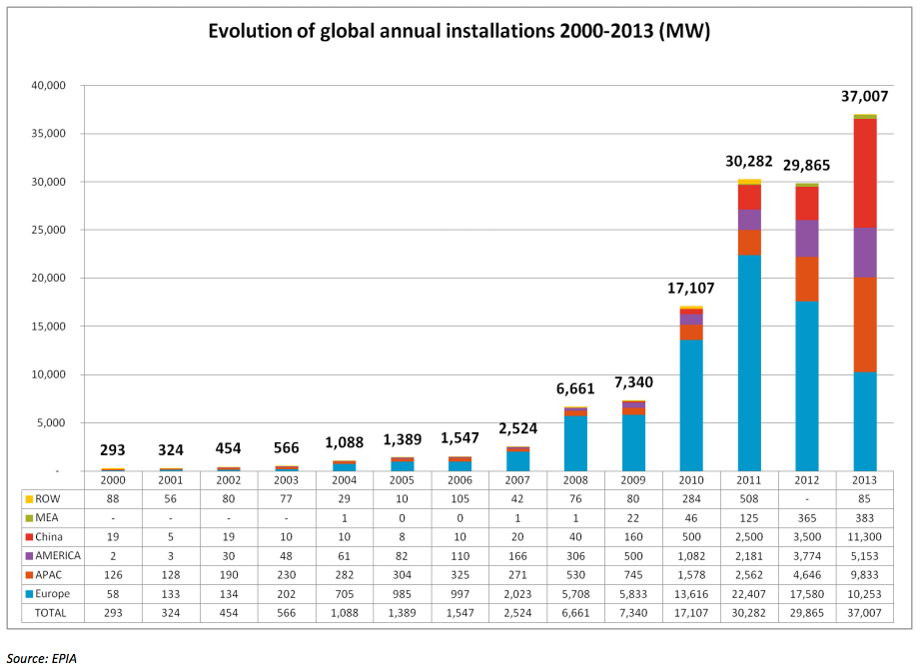
Worldwide PV Installation
Source:
https://en.wikipedia.org/wiki/
Growth_of_photovoltaics

Slide 8
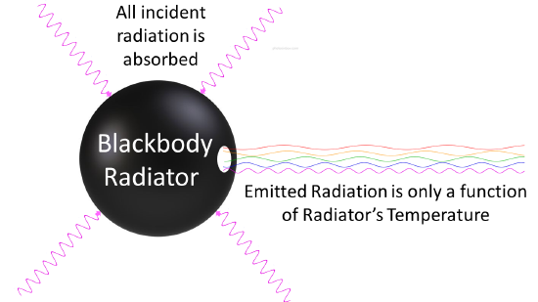
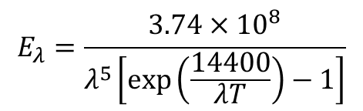
The solar spectrum
A blackbody is defined to be a perfect emitter as well as a perfect absorber.
The wavelengths emitted by a blackbody depend on its temperature as described by Planck’s law:
$$E_{λ}=\frac{3.74×{10}^{8}}{λ^{5}\left[\exp\left(\frac{14400}{λT}\right)−1\right]}$$

Slide 9
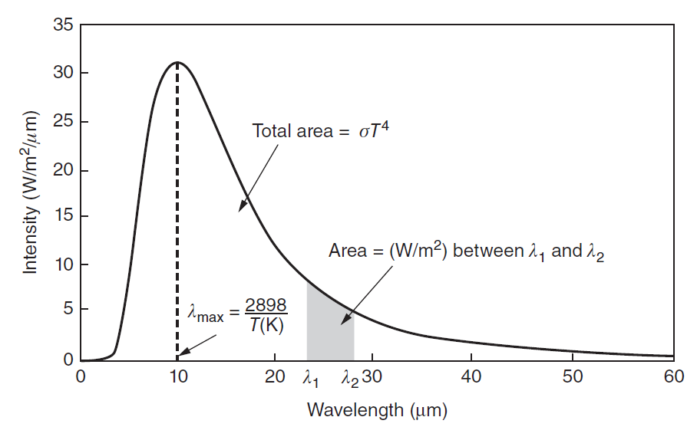

The solar spectrum
The area under Planck’s curve between any two wavelengths is the power emitted between those wavelengths, so the total area under the curve is the total radiant power emitted. That total is conveniently expressed by the Stefan–Boltzmann law of radiation:
$$E=σAT^{4}$$

Slide 10

The solar spectrum
Wien’s displacement rule tells us the wavelength at which the spectrum reaches its maximum point:
$$λ_{max}\left(μm\right)=\frac{2898}{T\left(K\right)}$$

Slide 11
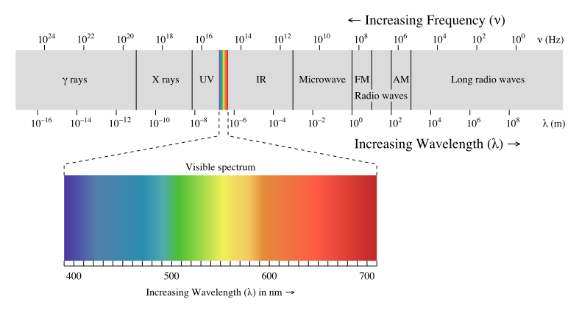
Electromagnetic Spectrum
Visible light has a wavelength of between 0.4 and 0.7 μm, with ultraviolet values immediately shorter, and infrared immediately longer
Source: en.wikipedia.org/wiki/Electromagnetic_radiation

Slide 12
Earth receives Sunlight and reflects Earthlight
The Earth’s atmosphere reacts very differently to the much longer wavelengths emitted by the Earth’s surface compared with the relatively shorter wavelengths arriving from the Sun.

Slide 13
Irradiance
A solar radiation makes its way toward the earth’s surface, some of it is absorbed by various constituents in the atmosphere, giving the terrestrial spectrum an irregular, bumpy shape.
The terrestrial spectrum also depends on how much atmosphere the radiation has to pass through to reach the earth surface.
If a point source radiates light uniformly in all directions and there is no absorption, then the irradiance drops off in proportion to the distance from the object squared, since the total power is constant and it is spread over an area that increases with the square of the distance from the source.

Slide 14
Air Mass Ratio
Air mass ratio: the length of the path h2 taken by the sun’s rays as they pass through the atmosphere, divided by the minimum possible path length h1, which occurs when the sun is directly overhead (solar noon):
“top” of atmosphere
h2
h1
h2
h1
beta
horizon
beta: the altitude angle of the sun

Slide 15
The earth’s orbit
The earth revolves around the sun in an elliptical orbit, making one revolution every 365.25 days.
The earth sweeps out what is called the ecliptic plane
Earth’s spin axis is currently 23.45˚
Equinox – equal day and night, on Mar. 21 and Sep. 21
Winter solstice – North Pole is tilted furthest from the sun
Summer solstice – North Pole is tilted closest to the sun

Slide 16
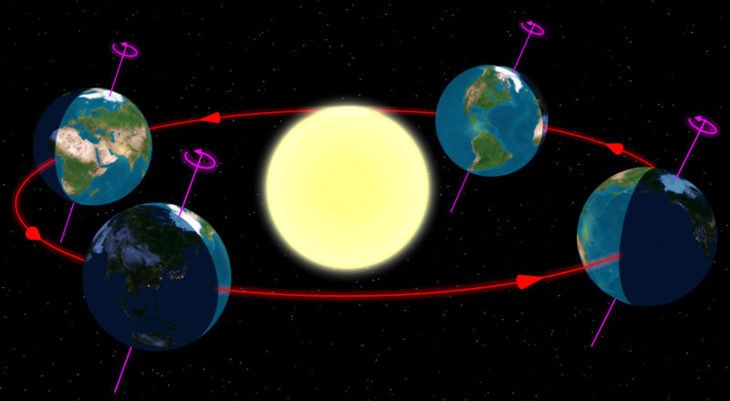
The earth’s orbit
The tilt of the Earth’s spin axis with respect to the ecliptic plane (red) causes seasons
152 Mkm
147 Mkm

Slide 17
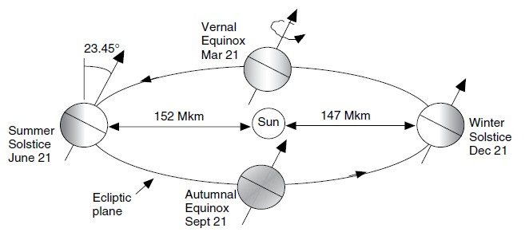

The earth’s orbit
This variation in distance is described by the following relationship
$$d=1.5×{10}^{8}\left\{1+0.017\sin\left[\frac{360\left(n−93\right)}{365}\right]\right\} km$$
where n is the day number,

Slide 18
Altitude angle of the sun at solar noon
In many situations, it is quite useful to be able to predict exactly where in the sky the sun will be at any time, at any location, on any day of the year.
Knowing that information we can, for example, design an overhang to allow the sun to come through a window to help heat a house in the winter while blocking the sun in the summer.

Slide 19
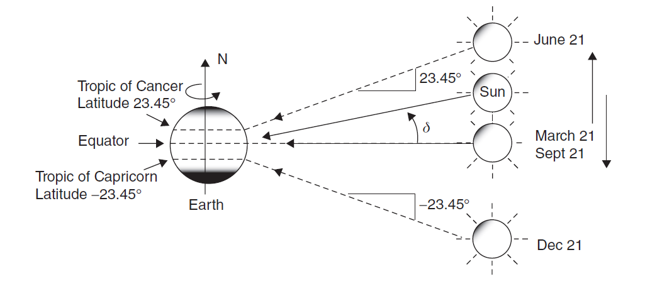
Altitude angle of the sun at solar noon
The angle formed between the plane of the equator and a line drawn from the center of the sun to the center of the earth is called the solar declination.

Slide 20
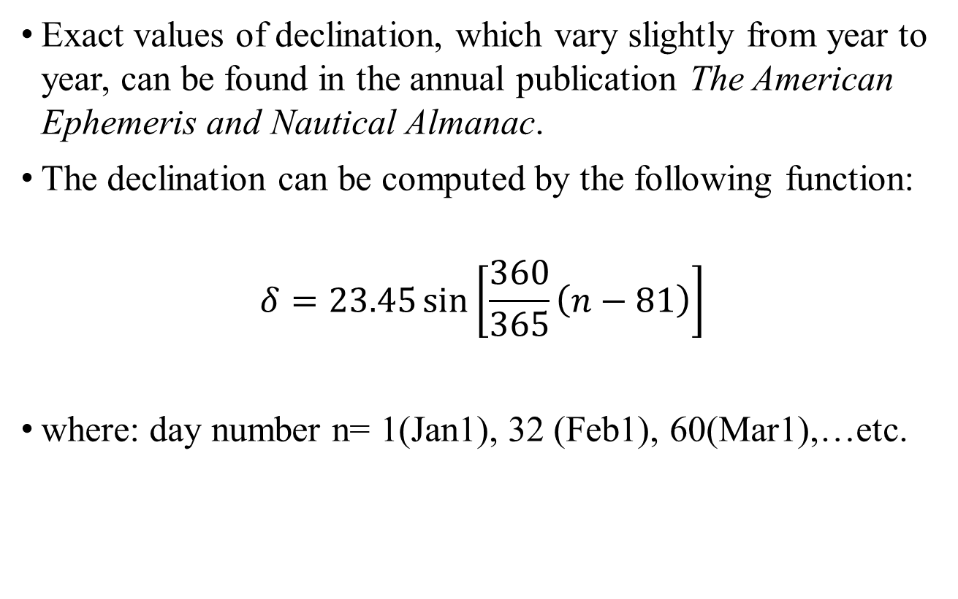
Altitude angle of the sun at solar noon
Exact values of declination, which vary slightly from year to year, can be found in the annual publication The American Ephemeris and Nautical Almanac.
The declination can be computed by the following function:
$$δ=23.45\sin\left[\frac{360}{365}\left(n−81\right)\right]$$
where: day number n= 1(Jan1), 32 (Feb1), 60(Mar1),…etc.

Slide 21
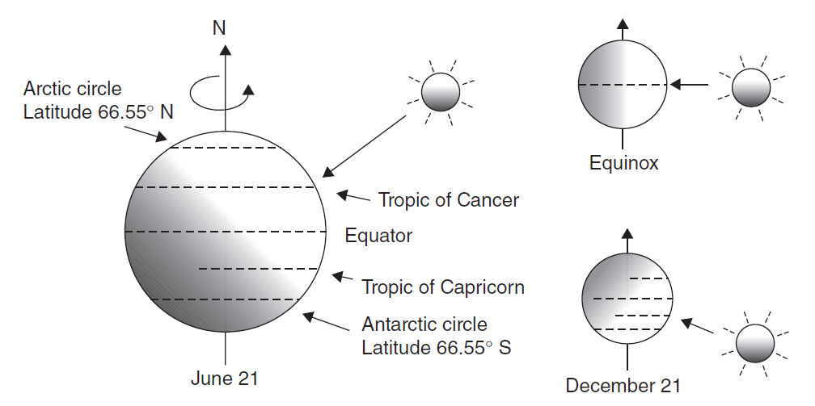
Altitude angle of the sun at solar noon
during the summer solstice, all of the earth’s surface above latitude 66.55◦ N (90–23.45◦) basks in 24 h of daylight, while in the southern hemisphere below latitude 66.55◦ S it is continuously dark. Those latitudes, of course, correspond to the Arctic and Antarctic Circles.

Slide 22
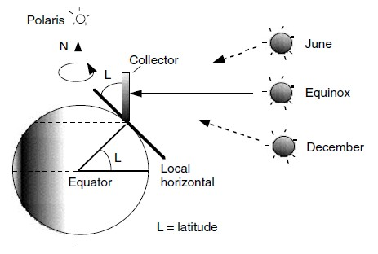
Altitude angle of the sun at solar noon
Solar noon – sun is directly over the local line of longitude
Rule of thumb for the Northern Hemisphere - a south facing collector tilted at an angle equal to the local latitude.
During solar noon, the sun’s rays are perpendicular to the collector face

Slide 23
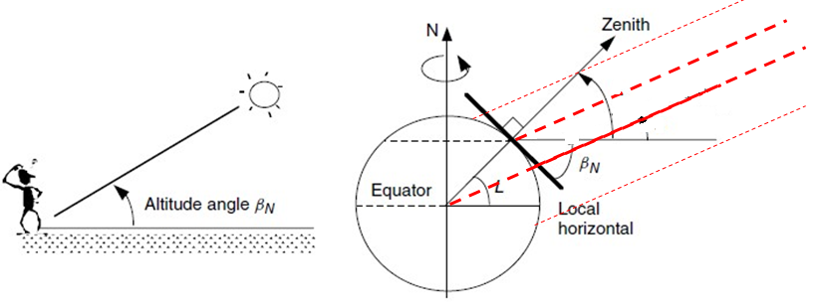




Altitude angle of the sun at solar noon
The altitude angle is the angle between the sun and the local horizon directly beneath the sun.
$$β_{N}=90°−L+δ$$
Solar Rays
$$L$$
$$δ$$
$$δ$$

Slide 24
Best tilt angle for PV module for the greatest insolation
Maximum annual solar collector performance at two equinox days:
  Achieved when collector is facing equator (south), with a tilt angle equal to latitude (assume northern hemisphere)
Why?
  In this geometry (the collector facing the equator with this tilt angle) the solar radiation it receives will be normal to its surface at the two equinoxes

Slide 25
Maximum Performance on Any Day
Maximum solar performance:
  Achieved when collector is facing equator, with a tilt angle equal to 90º - β_{N}
What is β_{N} ? Altitude angle: angle between the sun and the local horizon (this is a plane, not a line!) directly beneath the sun at solar noon:
So, for best performance, we need to adjust tilt of PV module:
(This still needs to be adjusted according to solar position; more later)

Slide 26
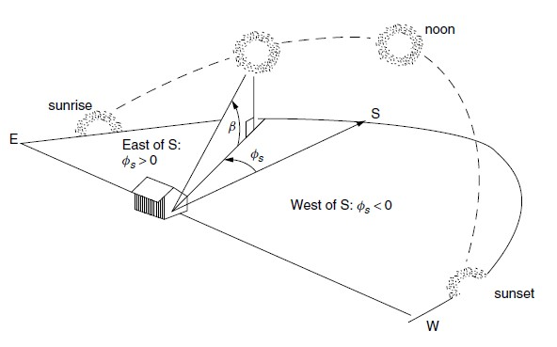

Solar position at any time of day
The location of the sun at any time of the day can be described in terms of its altitude angle β and its azimuth angle $φ_{s}$
Altitude Angle
Azimuth Angle

Slide 27
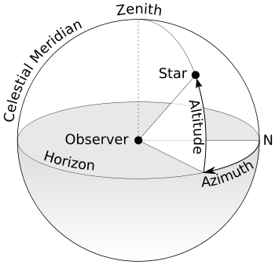
Solar position at any time of day
Azimuth is an angular measurement in a spherical coordinate system. It is defined by the angle between the projected vector and a reference vector on the reference plane, where projected vector is the vector from an observer (origin) to a point of interest and the reference vector usually points to north.

Slide 28

Solar position at any time of day
The following two equations allow us to compute the altitude and azimuth angles of the sun.
$$\sin{β}=\cos{L}\cos{δ}\cos{H}+\sin{L}\sin{δ}$$
$$\sin{φ_{S}}=\frac{\cos{δ}\sin{H}}{\cos{β}}$$
where: β=altitude, $φ$_{S}= azimuth, L=latitude, δ =declination, H=hour angle
Note: In spring & summer in early morning and late afternoon azimuth may be greater than 90º, so must be tested

Slide 29
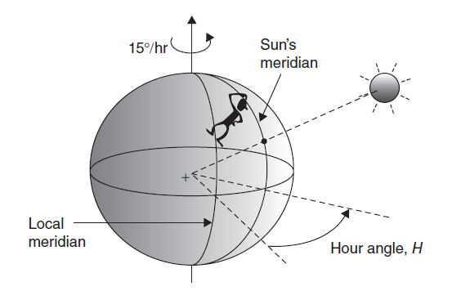
Solar position at any time of day
meridian: at any instant, the sun is directly over a particular line of longitude, called the sun’s meridian. The difference between the local meridian and the sun’s meridian is the hour angle, with positive values occurring in the morning before the sun crosses the local meridian.

Slide 30
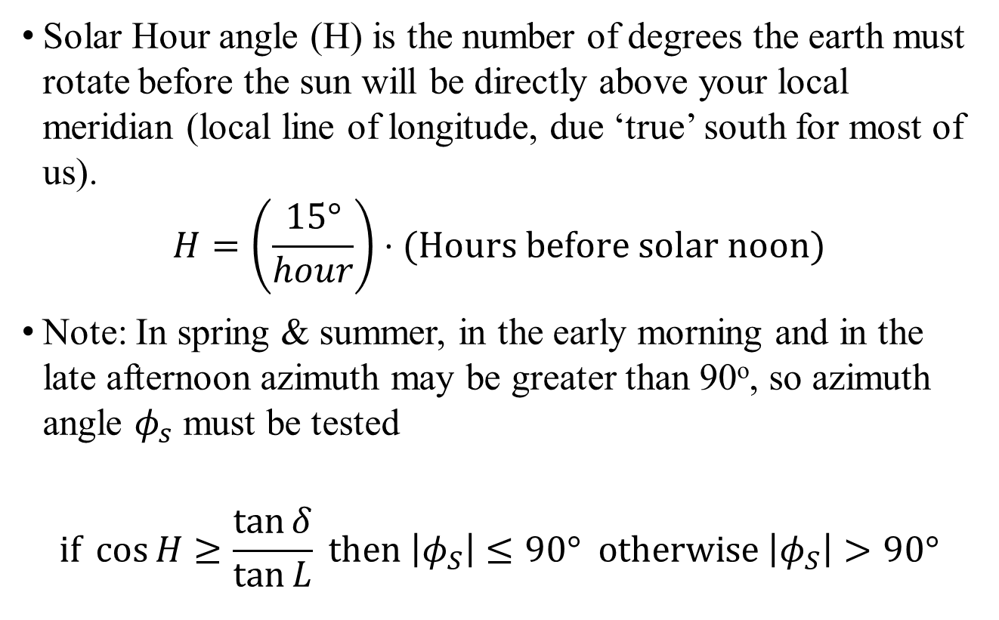
Solar Hour angle (H)
Solar Hour angle (H) is the number of degrees the earth must rotate before the sun will be directly above your local meridian (local line of longitude, due ‘true’ south for most of us).
$$H=\left(\frac{15°}{hour}\right)⋅(\text{Hours} \text{before} \text{solar} \text{noon})$$
Note: In spring & summer, in the early morning and in the late afternoon azimuth may be greater than 90º, so azimuth angle $φ_{s}$ must be tested
$$\text{if} \cos{H}≥\frac{\tan{δ}}{\tan{L}} \text{then} \left|φ_{S}\right|≤90° \text{otherwise} \left|φ_{S}\right|>90°$$

Slide 31
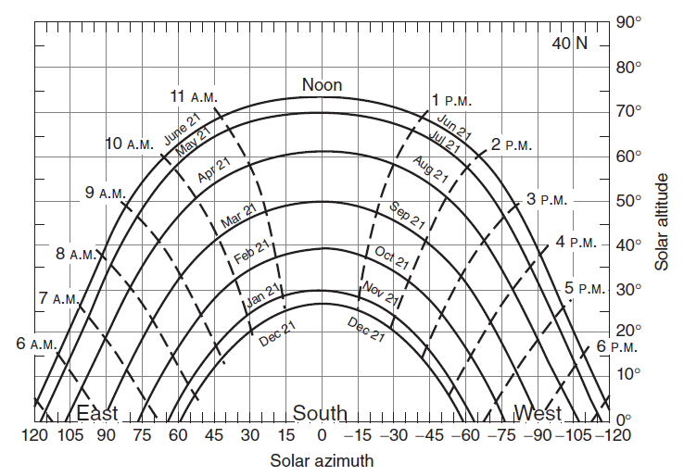
Solar position at any time of day
Solar altitude and azimuth angles for a given latitude can be conveniently portrayed in graphical form.

Slide 32
Sun Path Diagrams for Shading Analysis
Now we know how to locate the sun in the sky at any time; this is useful for perfect tracking of the solar rays
This can also help determine what sites will be in the shade at any time
Sketch the azimuth and altitude angles of trees, buildings, and other obstructions
Sections of the sun path diagram that are covered indicate times when the site will be in the shade

Slide 33
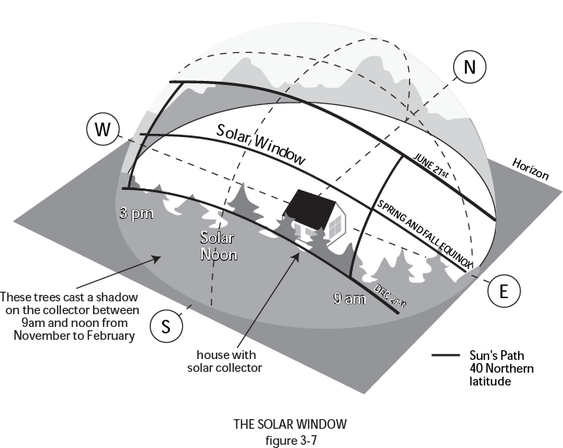
Maximize your Solar Window

Slide 34
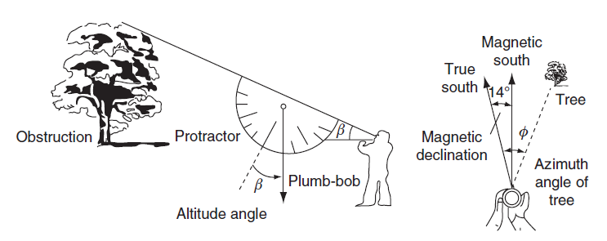
Sun Path Diagrams for Shading Analysis
Superposition of obstructions: tying the plumb-bob onto the protractor so that when you sight along the top edge of the protractor the plumb-bob hangs down and provides the altitude angle of the top of the obstruction.

Slide 35
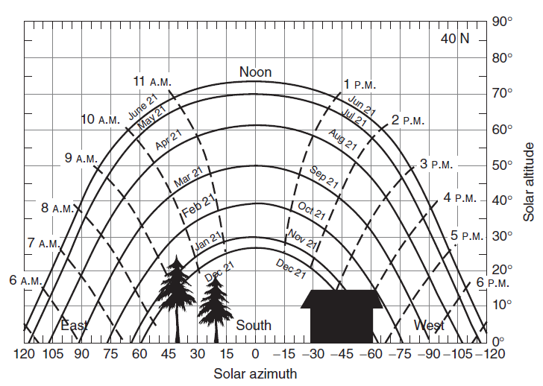
Sun Path Diagrams for Shading Analysis
The site is a proposed solar house with a couple of trees to the southeast and a small building to the southwest. In this example, the site receives full sun all day long from February through October. From November through January, about one hour’s worth of sun is lost from around 8:30 a.m. to 9:30 a.m., and the small building shades the site after about 3 o’clock in the afternoon.

Slide 36
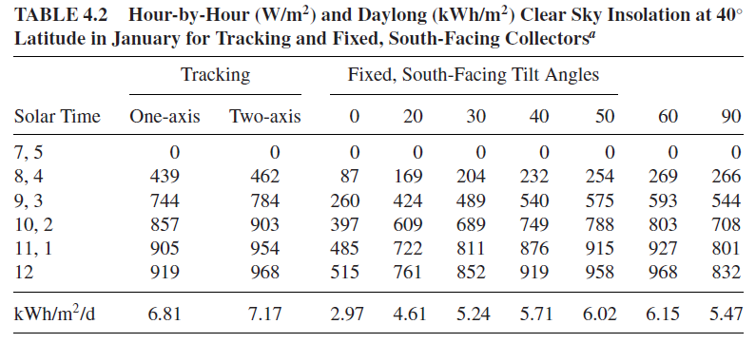
Sun Path Diagrams for Shading Analysis
The following table shows an example of the hour-by-hour insolations available on a clear day in January at 40◦ latitude for south-facing collectors with fixed tilt angle, or for collectors mounted on 1-axis or 2-axis tracking systems.

Slide 37
California Solar Shade Control Act
The shading of solar collectors has been an area of legal and legislative concern (e.g., a neighbor’s tree is blocking a solar panel)
California has the Solar Shade Control Act (1979) to address this issue
  No new trees and shrubs can be placed on neighboring property that would cast a shadow greater than 10 percent of a collector absorption area between the hours of 10 am and 2 pm.
  Exceptions are made if the tree is on designated timberland, or the tree provides passive cooling with net energy savings exceeding that of the shaded collector
  First people were convicted in 2008 because of their redwoods

Slide 38
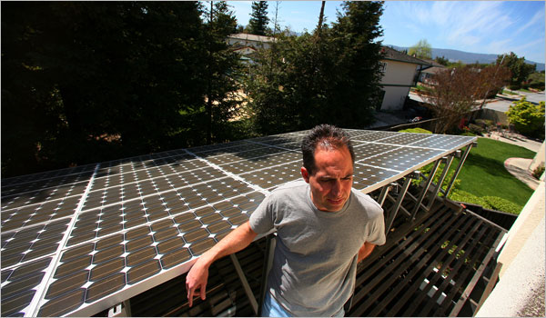
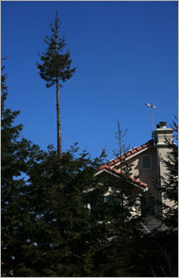
The Guilty Trees were Subject to Court Ordered Pruning
Source: NYTimes, 4/7/08

Slide 39
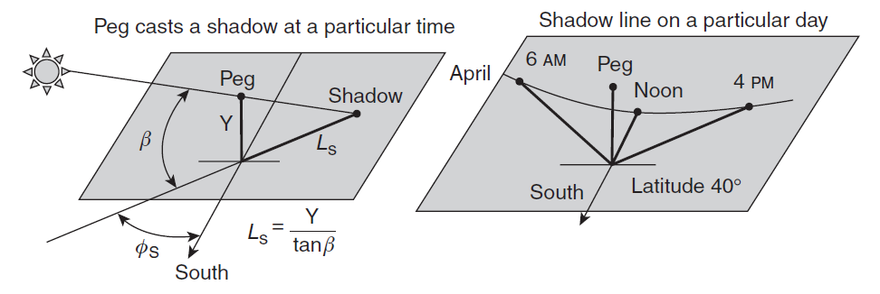
Shading Analysis Using Shadow Diagrams
The start of a shadow diagram for a particular day of the year at a particular location

Slide 40
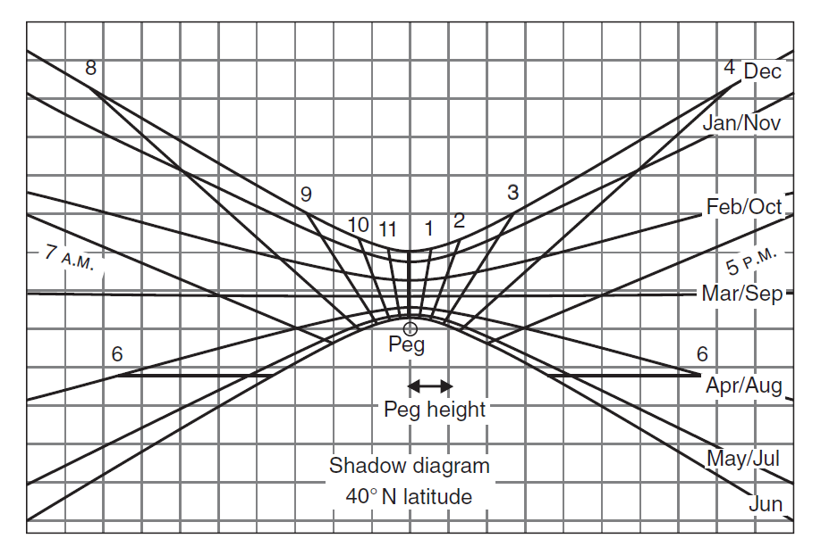
Shadow Diagram
By mapping out those shadow lines, month-by-month, a shadow diagram can be generated for any given latitude.
A Shadow diagram drawn for 40̊ N latitude. Curves are drawn for the 21st of each month.

Slide 41
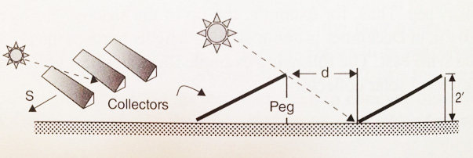
Example 4.5 Spacing For Rows of Collectors
Long rows of solar collectors lined up along an east-west direction are located in a spot at 40̊ N latitude. The backs of the solar racks are 2 ft high.
Use the shadow diagram in Figure 4.16 to decide how far apart the rows should be placed to assure no shading from one row to another anytime between 9:00 A.M. and 3:00 P.M.
Using Equation 4.8 and 4.9, what would the spacing be to avoid shading between 8:00 A.M. and 4:00 P.M.?

Slide 42
Example 4.5
Solution
a. Imagine a 2-ft-high peg at the back edge of a row of collectors as shown above. Clearly, the worst day, with the longest north-south shadows is the winter solstice, December 21st. From Figure 4.16 the longest shadow toward the north at 9:00 A.M. or 3:00 P.M. is close to three pegs long (3 squares back). With each peg being 2 ft high, the separation distance should be about
b. From Equation 4.8, using the solstice declination of and an hour angle H = 60̊ (4 h before solar noon):
So, from Figure 4.15, the length of the shadow at that time is

Slide 43
Example 4.5
From Equation 4.9, the azimuth angle of the shadow is
Since it is winter, we do not need to check to see if the azimuth is greater than 90̊. The north-south distance behind the 2 ft back of the modules is
We could have gotten this answer much more easily by just counting squares in the shadow diagram. Also note that spacing has gone from 6 ft to over 12 ft just to capture a modest amount of early morning and late afternoon sunlight (one more hour) during just a couple of winter months.

Slide 44
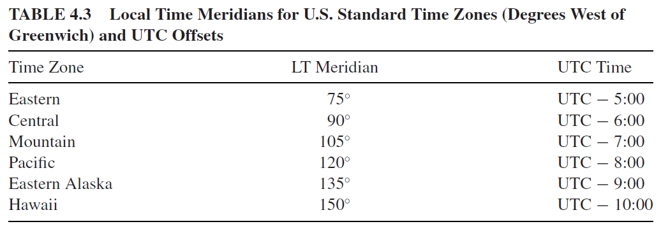
Solar time and civil (clock) time
For most solar work, it is common to deal exclusively in solar time (ST), where everything is measured relative to solar noon (when the sun is on our line of longitude).
Time zones around the world are expressed as positive or negative offsets from what used to be called Greenwich Mean Time (GMT), but what is now more precisely defined as Coordinated Universal Time (UTC).

Slide 45
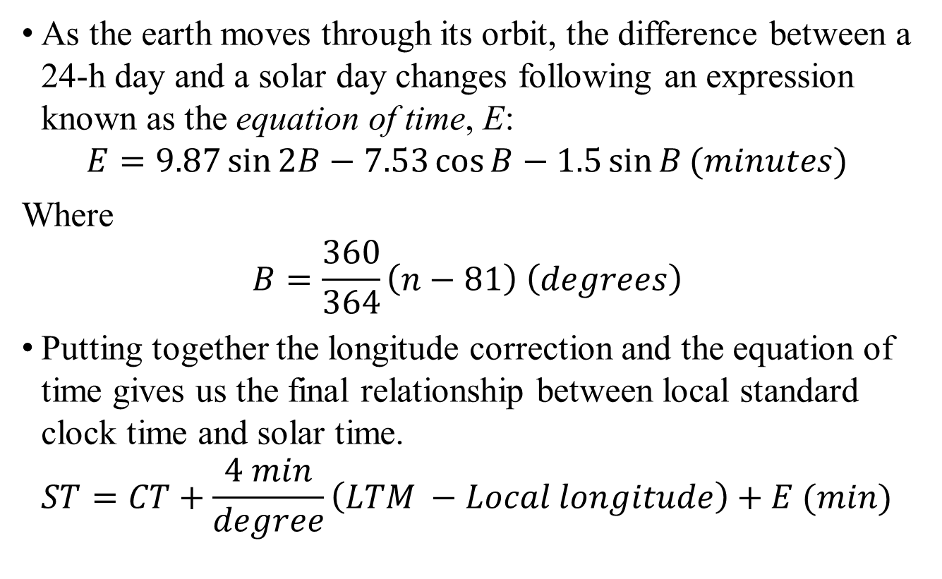
Solar time and civil (clock) time
As the earth moves through its orbit, the difference between a 24-h day and a solar day changes following an expression known as the equation of time, E:
$$E=9.87\sin{2B−7.53\cos{B}−1.5\sin{B}}(minutes)$$
Where
$$B=\frac{360}{364}\left(n−81\right) \left(degrees\right)$$
Putting together the longitude correction and the equation of time gives us the final relationship between local standard clock time and solar time.
$$ST=CT+\frac{4 min}{degree}\left(LTM −Local longitude\right)+E (min)$$

Slide 46
Solar time and civil (clock) time
The Equation of Time adjusts for the earth’s tilt angle and noncircular orbit.

Slide 47
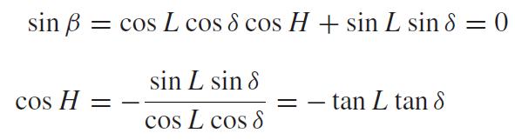
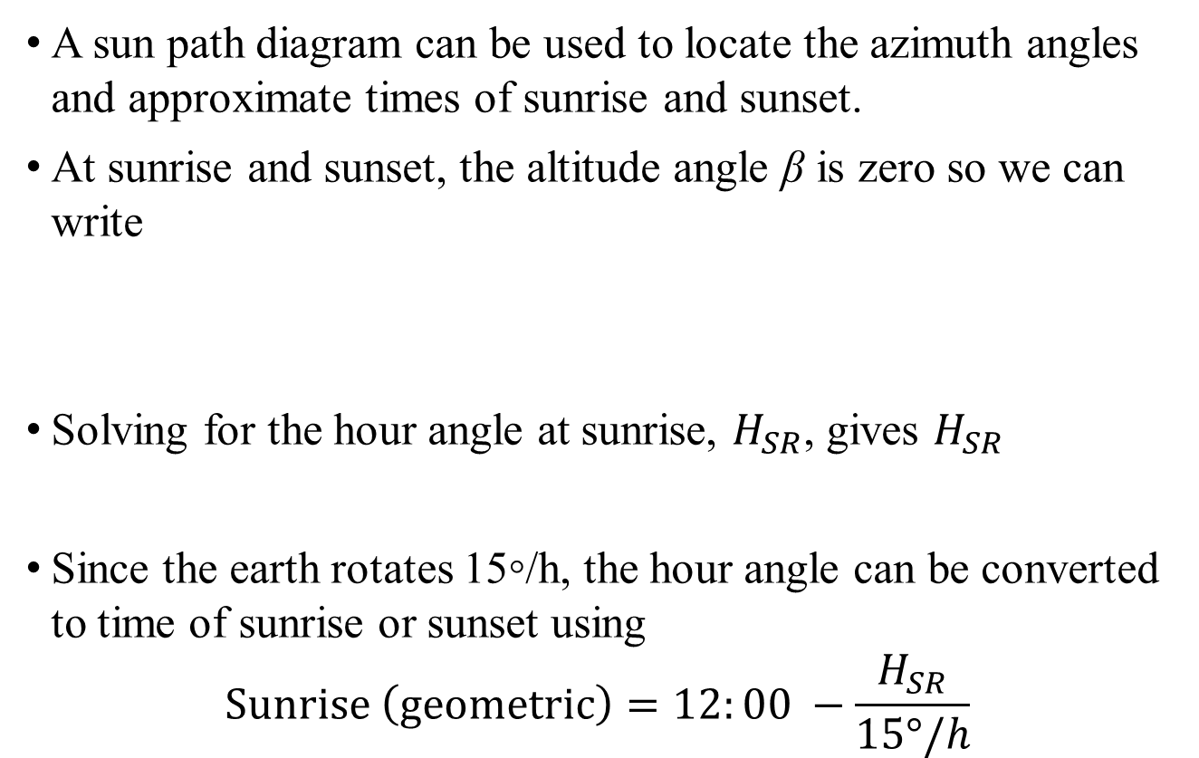
Sunrise and sunset
A sun path diagram can be used to locate the azimuth angles and approximate times of sunrise and sunset.
At sunrise and sunset, the altitude angle β is zero so we can write
Solving for the hour angle at sunrise, $H_{SR}$, gives $H_{SR}$
Since the earth rotates 15◦/h, the hour angle can be converted to time of sunrise or sunset using
$$Sunrise \left(geometric\right)=12:00 −\frac{H_{SR}}{15°/h}$$

Slide 48
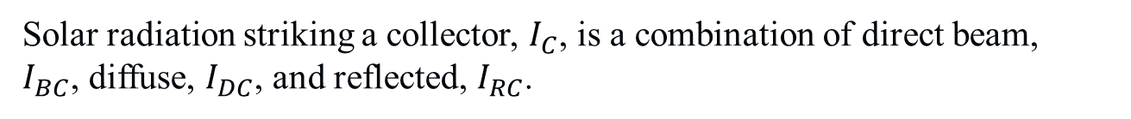
CLEAR SKY DIRECT-BEAM RADIATION

Slide 49
Total Solar Flux
Direct Beam
  Radiation that passes in a straight line through the atmosphere to the solar receiver (required by solar concentrator systems)
Diffuse
  Radiation that has been scattered by molecules and aerosols in the atmosphere
Reflected
  Radiation bouncing off ground or other surfaces

Slide 50
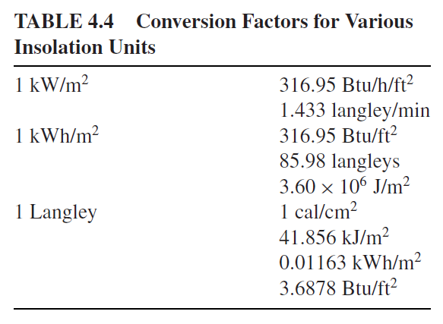
Total Solar Flux (units)
Other units involving British Thermal Units, kilocalories, and langleys may also be encountered. Conversion factors between these units are given in Table:
Conversion Factors for Various Insolation Units

Slide 51
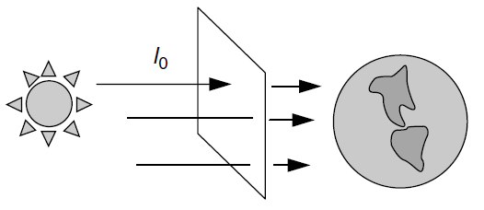

The extraterrestrial solar flux.
The starting point for a clear-sky radiation calculation is with an estimate of the extraterrestrial (ET) solar insolation, $I_{0}$, that passes perpendicularly through an imaginary surface just outside of the earth’s atmosphere

Slide 52
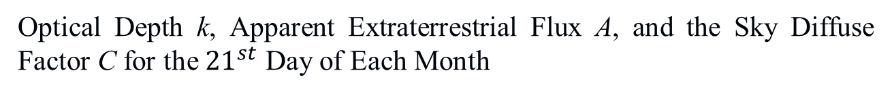
The extraterrestrial solar flux
I_B = A exp (-km)

Slide 53
Flux changes based on module orientation
Fixed Panel facing south at 40º N latitude
  40º tilt angle: 2410 kWh/m²
  20º tilt angle: 2352 kWh/m² (2.4% loss)
  60º tilt angle: 2208 kWh/m² (8.4% loss)
Fixed panel facing SE or SW (azimuth)
  40º tilt angle: 2216 kWh/m² (8.0% loss)
  20º tilt angle: 2231 kWh/m² (7.4% loss)
  60º tilt angle: 1997 kWh/m² (17.1% loss)

Slide 54
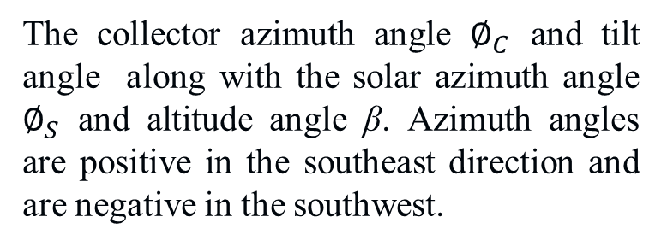


Total Clear Sky Insolation on a Collecting Surface
Direct-Beam Radiation
The incidence angle θ between a normal to the collector face and the incoming solar beam radiation

Slide 55
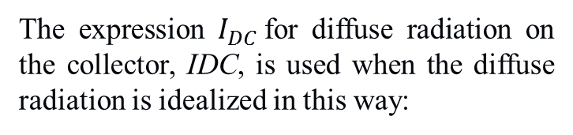
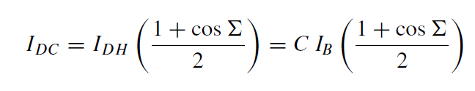
Total Clear Sky Insolation on a Collecting Surface
Diffuse Radiation
The diffuse insolation on a horizontal surface IDH is proportional to the direct beam radiation IB no matter where in the sky the sun happens to be:
where C is a sky diffuse factor
Diffuse radiation can be scattered by atmospheric particles and moisture or reflected from clouds.
Diffuse radiation on a collector assumed to be proportional to the fraction of the sky that the collector

Slide 56
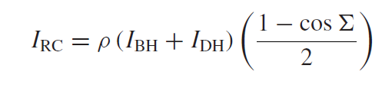

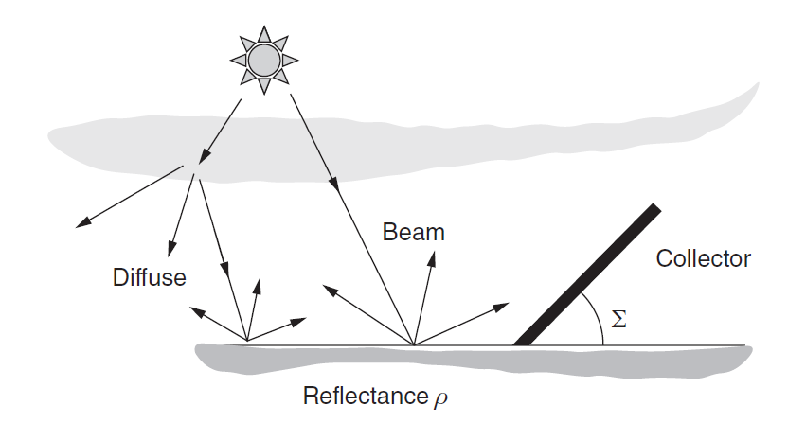
Total Clear Sky Insolation on a Collecting Surface
The ground is assumed to reflect radiation with equal intensity in all directions.
The fraction of that ground-reflected energy that will be intercepted by the collector depends on the slope of the panel

Slide 57
Tracking Systems
Most residential solar systems have a fixed mount, but sometimes tracking systems are cost effective
Tracking systems are either single axis (usually with a rotating polar mount [parallel to earth’s axis of rotation), or two axis (horizontal [altitude, up-down] and vertical [azimuth, east-west]
Ballpark figures for tracking system benefits are about 20% more for a single axis, and 25 to 30% more for a two axis

Slide 58
Benefits of tracking
Two axis tracking – track the sun both in azimuth and altitude angles
  3,305 kWh/m²
  37.1% improvement at 40º N latitude
Single axis – tracks only one angle or the other; if the tilt angle equals local latitude (called polar mount), rotates about its axis at the same rate as the earth turns, 15 deg/h, then the centerline of the collector will always face directly into the sun. The incidence angle of the sun’s rays will be equal to the solar declination angle.
  3,167 kWh/m²
  31.4% improvement at 40º N latitude

Slide 59


Tracking Systems
Two-Axis Tracking
Two-axis tracking angular relationships

Slide 60
Tracking Systems
Single-Axis Tracking
Two-Axis Tracking
A single-axis tracking mount with east–west tracking. A polar mount has the axis of rotation facing south and tilted at an angle equal to the latitude

Slide 61

Tracking Systems
Two-Axis Tracking
The effective tilt, which is the angle between a normal to the collector and the horizontal plane, is given by:

Slide 62


Tracking Systems
Four ways to do single-axis tracking for solar collectors
Two approaches rotate the collectors along a horizontal axis, with either a north–south or an east–west orientation. The other two have a fixed tilt angle; one rotates about a vertical axis and the other about a tilted axis.

Slide 63

Monthly and Annual Insolation
annual performance is relatively insensitive to wide variations in collector orientation for nontracking systems.

Slide 64

Monthly and Annual Insolation
For a fixed system the total annual output is somewhat insensitive to the tilt angle, but there is a substantial variation in when the most energy is generated

Slide 65

Solar radiation measurements
Creation of solar energy databases began in earnest in the United States in the 1970s by the National Oceanic and Atmospheric Administration (NOAA) and later by the National Renewable Energy Laboratory (NREL).

Slide 66

Solar radiation measurements
A map of the solar measurement stations is shown in Figure:

Slide 67
Solar radiation measurements
By temporarily affixing a shade ring to block the direct beam, a pyranometer can be used to measure just diffuse radiation

Slide 68
Solar radiation measurements
The most accurate of these incorporate a sensor surface that consists of alternating black and white segments

Slide 69

US Annual Insolation

Slide 70

Worldwide Annual Insolation
TOTAL INSTALLED PV capacity: In 2007 worldwide PV peak was about 7800 MW, with almost half (3860 MW) in Germany, 1919 MW in Japan, 830 MW in USA and 655 MW in Spain

Slide 71
Solar insolation under normal skies
Of greater importance is estimating the radiation that will be seen on a collector under more realistic conditions.
The NSRDB provides the starting point for creation of what is called a typical meteorological year (TMY) database of location-specific hour-by-hour insolation and weather data.

Slide 72

Solar insolation under normal skies
We can convert terrestrial DNI and DHI data into hourly irradiation onto any of the tracking or fixed-orientation solar collector with the following equations:

Slide 73

Average monthly insolation
Historically, most of the long-term collected site-specific data have been insolation measured on a horizontal surface.
One approach to convert these older data into expected radiation on a tilted surface depends on sorting out what portion of the total measured horizontal insolation ${\overline{I}}_{H}$ is diffuse ${\overline{I}}_{DH}$ and what portion is direct beam, ${\overline{I}}_{BH}$.
$${\overline{I}}_{H}={\overline{I}}_{DH}+{\overline{I}}_{BH}$$

Slide 74

Average monthly insolation
Radiation data for Boulder are plotted below:

Slide 75
End

